Slide 1
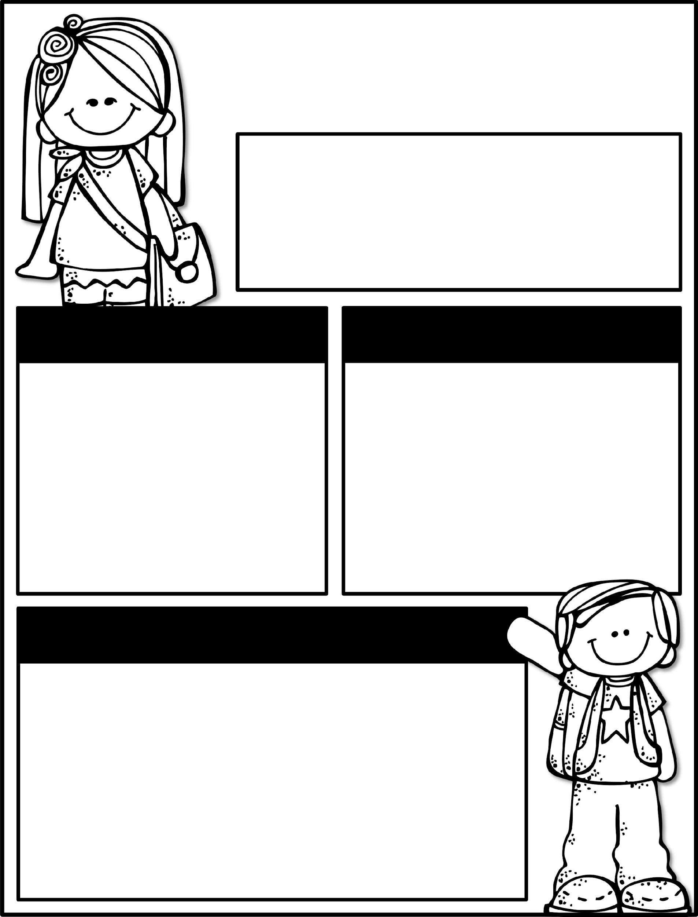

Kindergarten News
November 4-8, 2024
Class News
Learning Focus
Please plan to attend PTO’s Fall Festival on Friday, 11/8. PTO welcomes any volunteers! Continue to work with your student on his/her heart word folder to master the sound and word lists. Each list completed earns “lunch bunch” with the teacher and/or other fun incentives.
Our field trip is on Monday. Please have your student wear socks. Also, please let your child’s teacher know their shoe size for skates. There will be no school for students on 11/5.
Upcoming Events
Learning Focus
11/4 - Field Trip
11/5 - No School for students
11/8 - Fall Festival
11/13- Veterans Day Celebration
11/22- Thanksgiving Feast at 1 pm (more info to come - parents are invited)
11/25-11/29- Thanksgiving Break
Birthdays
Harley 11/17
Zion 11/22
Reading: Asking and answering questions about key details, characters, and setting of the text
Writing: Informational text
Math: Counting to 100 by 1s and 10s
Phonics: Letters / Letter sounds / Blending to read and write words
Social Studies: Maps and Globes
Sight Words to practice
a, the, as, to, do, I, is, am, at, an, in, it, was, you, of, for, from, your, said, all, put
Contact Me:
Email: olivia.otis@henry.k12.ga.us
School Phone Number: 770-898-7362
Reminders
Please check your child’s binder each night. Check Dojo each night.
Please send a water bottle and daily snack for your child.
Please keep a change of clothing in your child’s bookbag for accidents.
Student attendance is essential for academic success. Please have your child at school before 7:35am. If your child is sick, he/she needs to be symptom free for 24 hours before returning. Please send a signed school excuse on the day your child returns.

